Slide 1


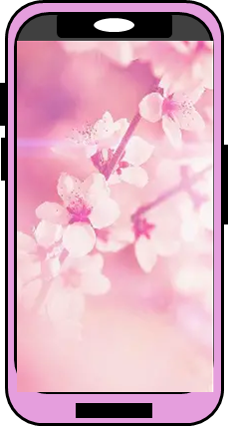


Introducing
Annex.
My background is going to be this bitmap image of pink gradient with different shades of pink.
“introducing annex “ will be written in the top left corner lie this.. It will be in font style Bodoni MT Black and size 36. the colour will be black.
Here I will have the front facing and back facing images of my phone.
“ add power add style“ will be written in the bottom right corner lie this.. It will be in font style Bodoni MT Black and size 36. the colour will be black.
This will be a palm tree leaf that is placed behind the blocks and phone. It will show the elegance of the phone and make the advert look aesthetic.
Add power
Add style
These will be two platforms that the phonbe is resting on.; they will be pink blocks.
Notes:
The purpose od the advert is advertising my smartphone annex. It will promote the phone and encourage people you but it. The advert shows the elegance of the phone with its complimentary colours and theme. The leaf compliments the soft background. The font size and font style of the text makes it stand out more. This will be a key selling point of this phone through this advert.
The target AUDIENXCE for my phone will be any customers who want to buy a new phone and anybody interested in new technology. The target audience for my phone will be all people in all age ranges including teens, young adults and businesspeople.

