Slide 1
Graphics products
anisa

Slide 2

Notes:
The intended purpose of BMW logo is to represent the brand and identify its vehicles
The BMW logo is a vector graphic which means that it can be put to any size without loosing its quality.
The BMW placed on the outer circle stands for Bavarian Motor Works. The text is written in bold to make their name clearly visible and well known.
The logo used circular composition and gives a structured layout making it look neat and professional. Makes it look appealing to look at.
This logo has a limited, simple, chic colour palette of black, grey, blue. The colours blue and white are part of BMW’s heritage which means when you look at it you already know what brand it is. The black add a sophisticated, luxury look.
This logo is fit for its purpose because its highly recognisable and even though its very simple it still gives off something unique. The vector-based design allows this image to be sized however which means its effective if anyone wants to use it for advertisements, websites. The circular and symmetrical shape allows for it to reflect BMW’s reputation for high quality engineering. The logo is effective at informing and identifying the brand
The BMW logo educates audience about communicating information about the brand identity. It appeals to different audiences for adults is shows professionalism and at that age people have more interests in cars like BMW.
Some strengths of this logo are easily recognisable and stands out. Another strength is when you look at the logo you know that it’s a luxury car brand which means that even if you look at the logo you know it’s a well-known brand.
Some weaknesses of this logo is that its very simple and not as much eye catching and interesting.

Slide 3
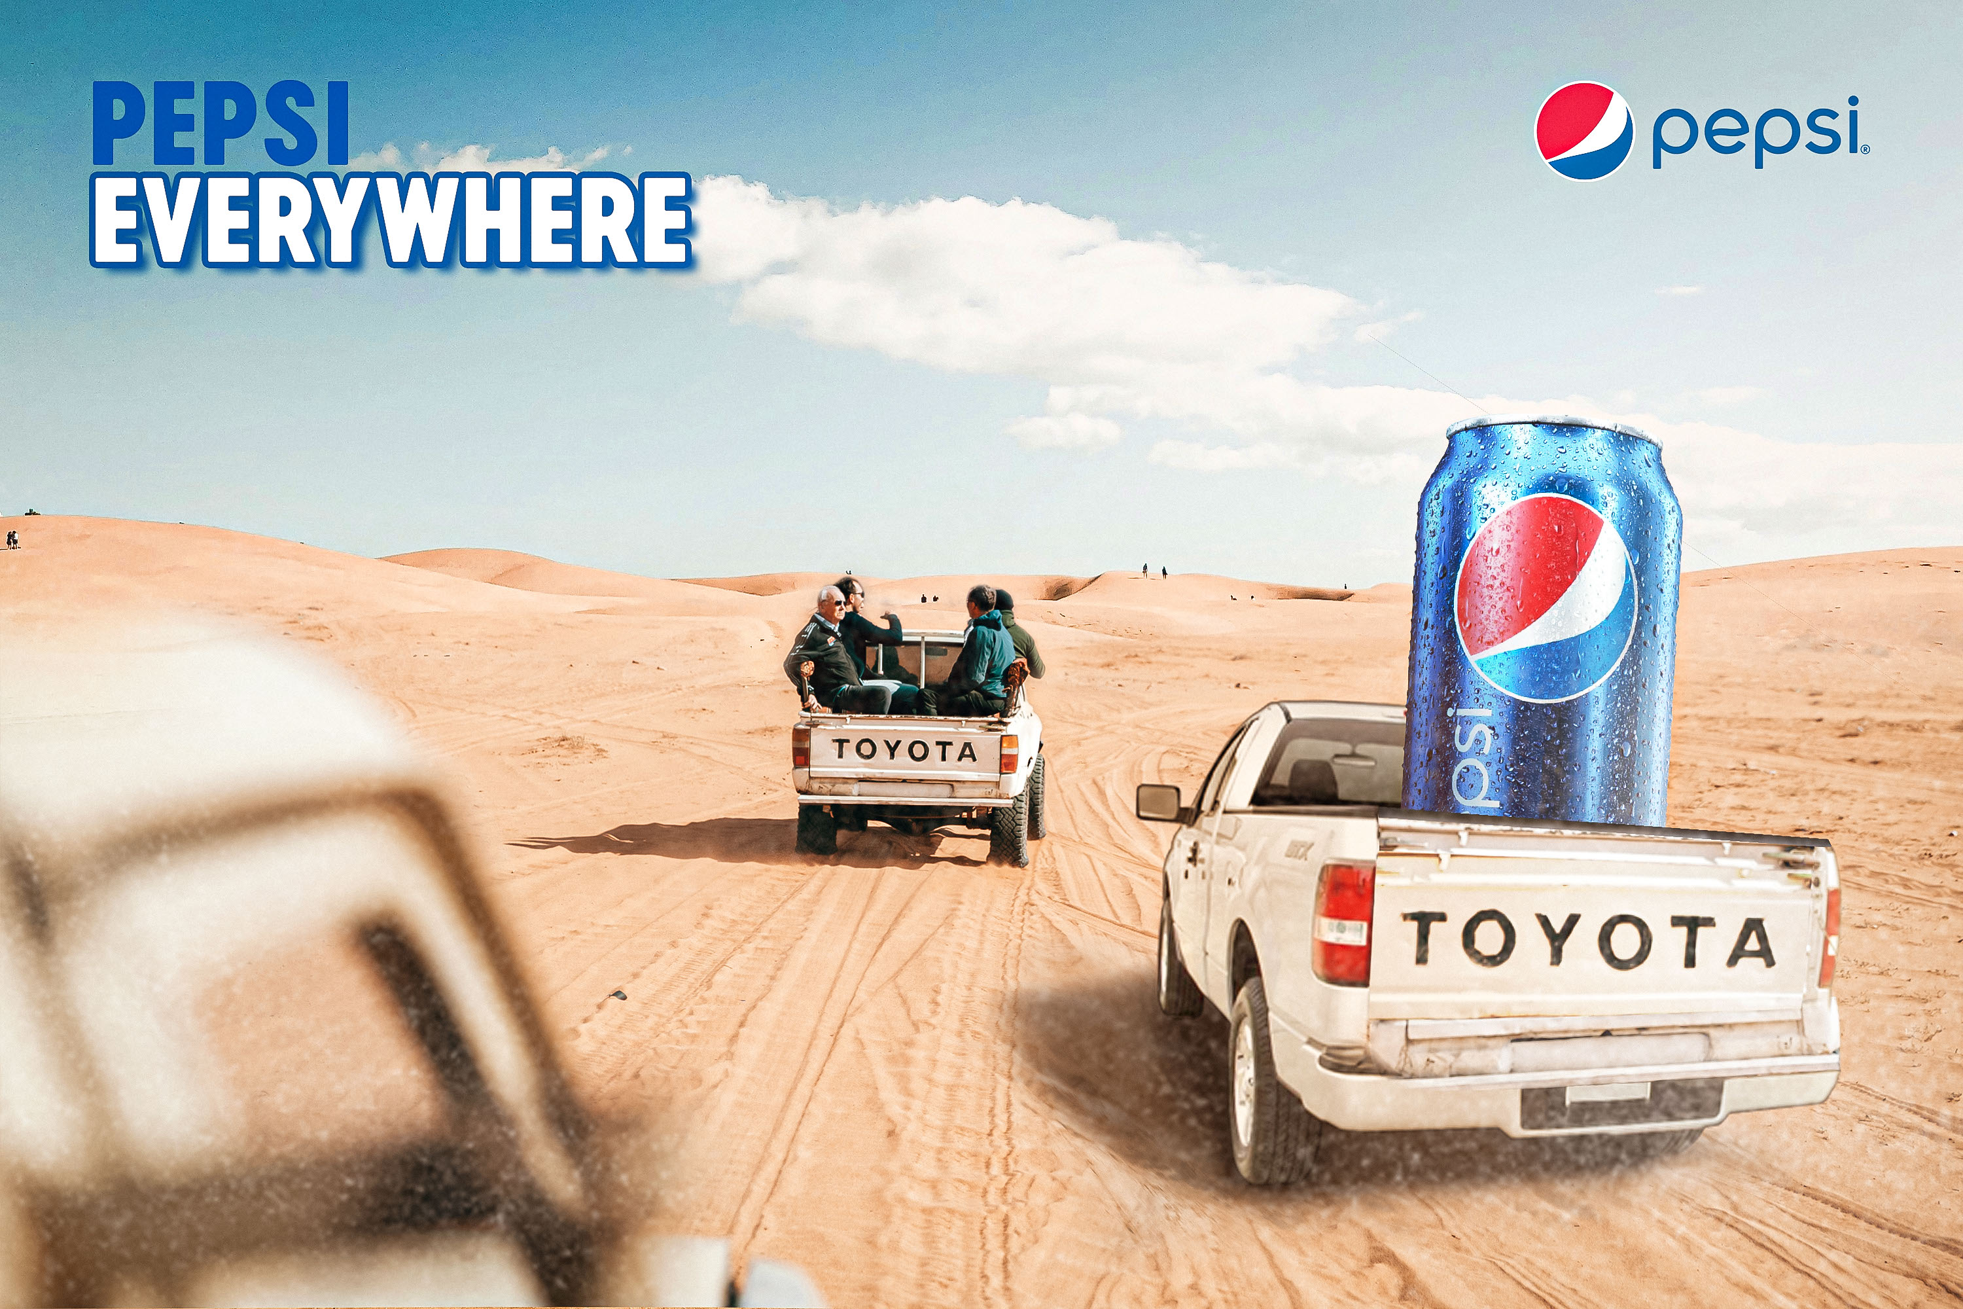
Notes:
The intended purpose of this advert is to promote the brand of Pepsi, persuade customers to buy Pepsi by presenting it as a drink that is available everywhere and fits into any lifestyle.
This advert is to create a good brand image by making it look unique and fun.
This advert is a bitmap image. The text of this advert ‘’PESPSI EVERYWHERE’’ reinforces that Pepsi is worldwide and wherever you go even a place like the desert you'll be able to find a Pepsi. The bold, capitalized, short slogan shows that it's easy to see and that they don’t have much to say as you should already know how good the brand is. The beige tones dominate the background. The blue, red and white colours of the Pepsi brand strongly contrasts with the desert which then makes the brand and product stand out more. The sizing and position of this is that the can is oversized which symbolized importance. The can being on the right side draws the attention of the viewer. And then the slogan balances the image visually.
The characters in this advert at the people in the truck who are shown are enjoying their time being at the desert with Pepsi. Objects are the trucks and the can.
This advert is fit for its purpose because its very eye catching and persuasive as that is what the intended effect is meant to be which they have successfully achieved. It is effective at invoking emotion like thirst, desire appetizing. For younger audience this may catch their eye as it looks vibrant and fun which youngers may be interested in.
Some strengths of this advert is that its fit for its purpose and is very eye catching, persuasive. It also has given you a clear message from the slogan so its easy for anyone to understand. Lastly, the wide audience appeal is effective as its for everyone without it being for a specific group of people.
Some weaknesses of this advert could be the unrealistic imagery as people may think its just fake and there's no realness behind it. Another weakness is that it may be too generic as the slogan doesn’t differentiate from any of the other drink brands.

