Slide 1
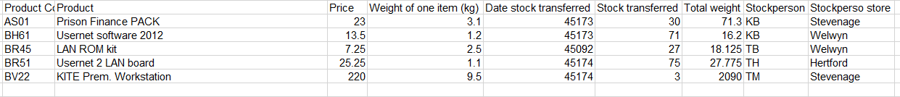
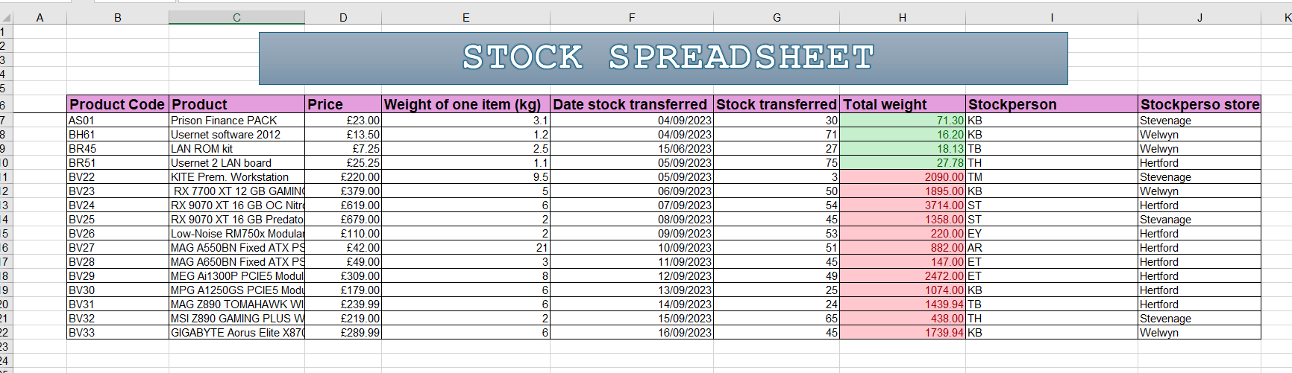
Spreadsheet 1 - Stock
Anisa begum
Unit 9
Notes:
The purpose of this spreadsheet is to show stock data and the prices of stocks. The weight of stocks tells the person who's handling them; how much they weigh. The product names help recognise which specific products are in stock and the data information on each product.
One feature I used was autofill which made it easier for me to put the information down quick and efficiently. Another feature I used was conditional formatting to see which products are under or above 100 so I can identify them quickly, so as I used the colour red which means above 100 and green which is below . Another feature I used was cell formatting which was the use of different fonts and colours to make it look presentable. A feature I also used inserting columns which was for me to add any extra information. I used formulas to make it easier for me to calculate the total weight of stock by multiplying or adding each cell together (e.g. = G3*H3) . I also made it landscape from portrait so I can spread the data out for easy read. I furthermore used wrap text to make sure the writing doesn’t go out of the cell, and it makes it look neater. I formatted the currency/date, so it fits into the right category, and it indicates to the reader what the number means. Then I formatted it into 2 decimal points as currency has 2 decimal places along with the pound sign.
Auto fill makes it easier to input the data by just dragging the cell down and it will automatically work out all the correct information needed (E.g. If I input January and then by dragging it down it will automatically appear with all the months in a chronological order.) This also increases productivity as its very quick and saves you time from writing it down manually. This improves accuracy as its automatically inputs all the data without me accidentally making any mistakes. This feature makes it faster, reliable and efficient.
A few strengths of this spreadsheet is that its very organised as it keeps stock names, prices and dates all in one place, it helps me identify information easily. Another strength is that it provides me with automatic calculations without me wasting any time having to manually type it in, this is seen as a strength because the calculations are accurate. The last strength is that it also allows me to track all the stocks that are incoming/outgoing and how it is performing.
A few weaknesses of this spreadsheet is that there should be titles to make it clear what this is about so anyone else who edits this doesn’t get confused when they look at it. Another weakness is that shading should be added so I know which one of the products sell best so I can put more of them in stock. A last weakness is that a pivot table feature should be added so you can summarise and analyse stock data efficiently.

Slide 2
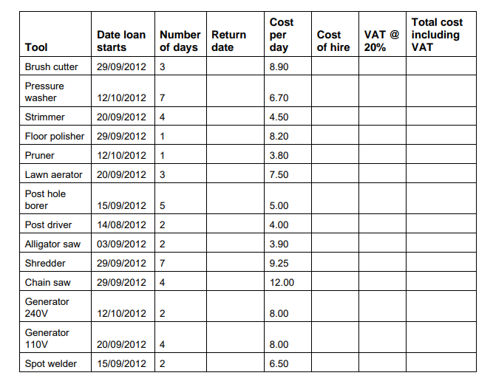
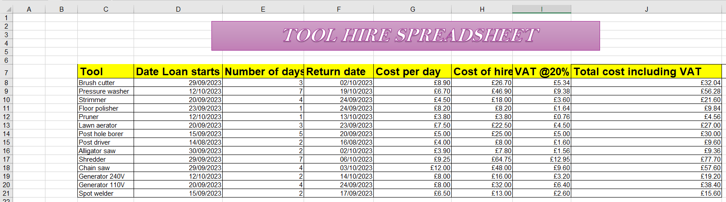
Spreadsheet 2 – Tool hire
Anisa begum
Unit 9
Notes:
The purpose of this spreadsheet is to present the data of a company allowing people to hire tools. It displays the loan dates, when they have borrowed them and when it was returned. It also indicates how much it cost to hire specific products and how many days you have had them for. It highlights all the additional costs that comes with it such as VAT.
One feature that I used was conditional formatting to add colour and borders, so it looks more visual. Another feature I used was wrap text to help keep the cells tidy. I also used formulas to make it simpler for me to work out the total cost of the tool and it gave me quick calculations (e.g. cost of hire = number of days * cost per day). I did autofill to automatically give me the rest of the calculations that I was working out without me having to individually work them out. I formatted currency/date to understand it further without just seeing numbers. Then I formatted the prices to 2 decimal places as currency comes with two decimal points. I added columns for any tools that have been added to the spreadsheet. I turned it from portrait to landscape so all of it is more visible to see. I inserted ‘current dates’ which is efficient for me as it automatically gives the dates which helps me with date loans as I don’t have to put in so many numbers. I inserted a name header which indicates to other editors who created it and when it was made.
By using formula calculations, this aids usability because it gives me swift calculations (e.g. = G3*H3). This increases productivity as it is more rapidly done and it doesn’t need me to work out any of the calculations because then I can use auto fill, and it provides the rest of the calculation. This improves accuracy as they are working out for you, so it means you don’t have to worry about human errors.
Some strengths of this spreadsheet is that is allows me to track orders, how many days they are taking them for and calculate their total costs. Another strength of this is how much income the business is making from tool rentals and has all the financial details written about it. The last strength is that its kept organised as all of it is in its own column and the data about each tool which makes it easier for me to manage customer orders.
Some weaknesses of this spreadsheet is that some information of customer orders may be incorrect, and I can lose track of their data. Another weakness of this is that names of customers should be added as an extra column because I can mix up orders as I don’t know who's it is. The last weakness of this is that each customer should have a highlighted cell/row so its easier for me to know that its this customer and avoid confusion.

